Slide 1
Customer Segmentation Analysis
Identifying Target Groups for Marketing Strategy

Slide 2
Project Purpose
The Customer Segmentation project applies unsupervised learning (K-Means clustering) to identify meaningful shopping groups within the customer base.
By analyzing age, annual income, and spending scores, the project helps the marketing team design personalized strategies that maximize engagement and ROI.

Slide 3
Business Problem & Goal
Problem:
Marketing campaigns risk being ineffective without clear segmentation.
Goal:
Identify customer clusters based on age, income, and spending behavior to enable data-driven targeting.

Slide 4
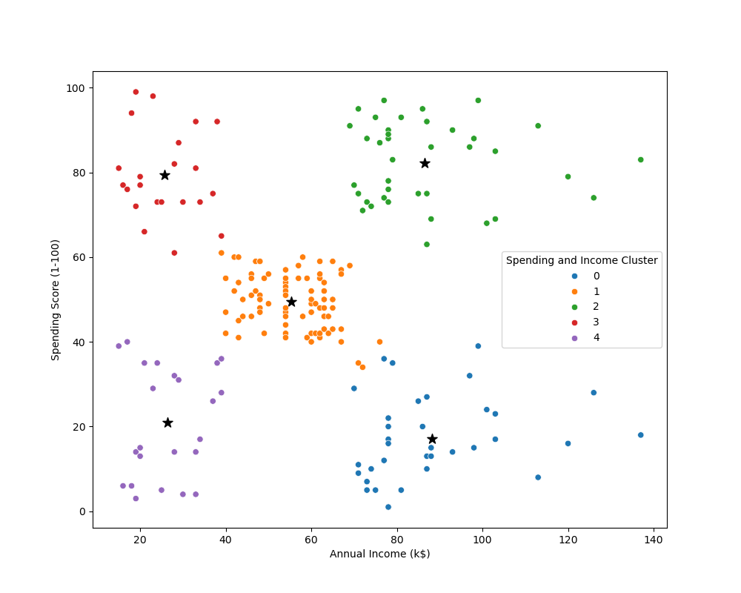
Cluster Insights
Cluster 2: Affluent Enthusiastic→ Premium & Personalized Marketing
Cluster 4: Middle-Aged Budget Customers → Discounts/promotions
Cluster 0: High-Income Low Spenders → Upselling & loyalty campaigns
Cluster 1: Balanced Shoppers → Stable mainstream base
Cluster 3: Young High Spenders → Luxury/lifestyle marketing

Slide 5
Business Impact & Strategic Takeaway
Tailored campaigns for clusters allow:
• Maximized ROI
• Reduced wasted spend
• Improved customer retention
• Alignment with customer behavior

Slide 6

Summary & Insights
The analysis identifies five customer clusters, with Young High Spenders and Affluent Enthusiastic Shoppers as the most valuable targets for luxury, lifestyle, and premium campaigns.
High-Income Low Spenders offer growth potential through upselling and loyalty programs, while Balanced Shoppers form a reliable mainstream base.
Budget-Conscious Older Customers remain engaged through discount-driven promotions, ensuring broad coverage across the market.

